Slide 1
Linear Asset Pricing Models
This slide set is largely consistent with Ang Chapter 6.

Slide 2
CAPM

Slide 3
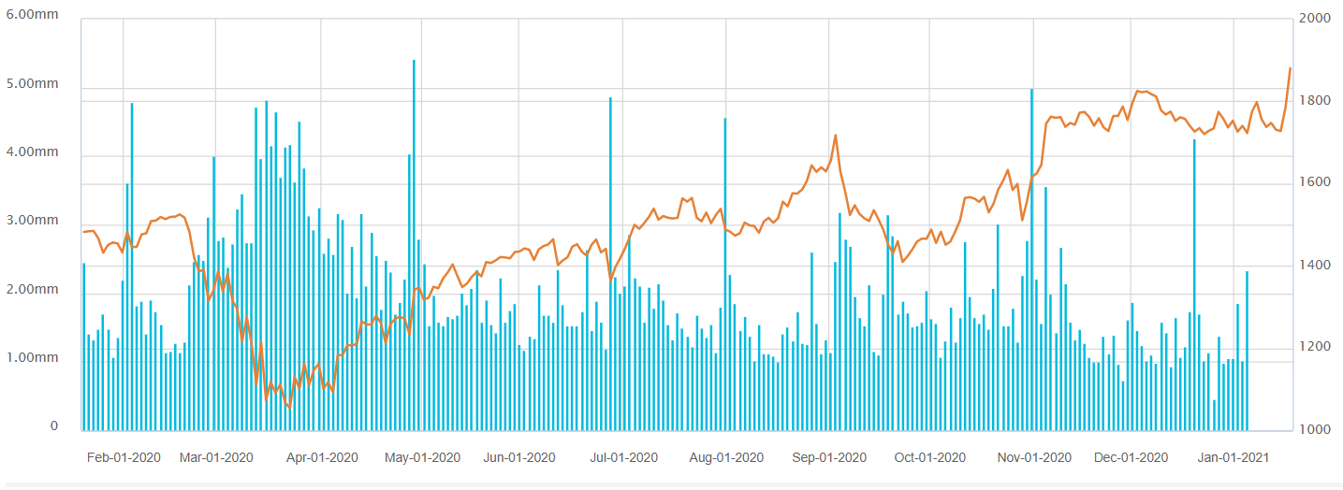
Risks in asset pricing
William Sharpe (Nobel Prize, 1990) in an interview with the Dow Jones Asset Manager in 1998:
“But the fundamental idea remains that there’s no reason to expect reward just for bearing risk. Otherwise, you’d make a lot of money in Las Vegas. If there’s reward for risk, it’s got to be special. There’s got to be some economics behind it or else the world is a very crazy place.”
Risks in a stock:
Total risk
Systematic risk(s)?
Return, fundamentals, trading, information, ownership, etc.?
GOOG stock price

Slide 4
Capital Asset Pricing Model (CAPM)
Investors are only rewarded for bearing systematic risk
They should not be rewarded for bearing non-systematic (idiosyncratic) risk
Two parts of risk

Slide 5
“beta”
Covariance of return of the security with the market. Why?
In a multi-asset market, risk measures not how a stock influences itself, but how it influences all others.
Market risk cannot be diversified away (What makes a market portfolio risky?)
As the number of securities is large, covariances become the most important determinants of a portfolio’s variance
For example, if there are 1,000 stocks, there are 1,000 variance terms; however, there are 1,000(1,000-1)/2 = 499,950 unique covariance terms!
Beta aggregates the covariance terms related to (and thus contributed by) stock i.
How much stock i contributes to the market risk
For a risky asset r_{i}, the right measure of the rewardable risk is not its variance, but its covariance with the market.

Slide 6
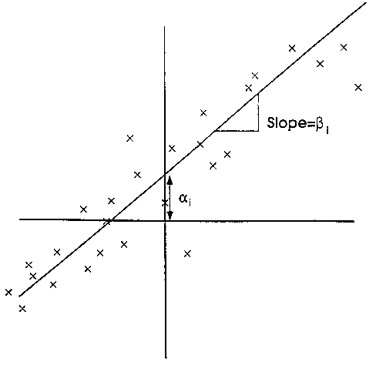
“alpha”
Fitting the CAPM for stock i
If the model is “correct”, alpha = 0.

Slide 7
Risk and diversification in CAPM
In the CAPM there is only one market factor (risk).
What is the risk in the CAPM that require return compensation
Investors hold the market portfolio. Holding company-specific risk leads to lower expected total return and can be diversified away (through covariances).
All stocks carry market risk exposure (few assets have zero exposure).
Higher exposure, higher expected returns.

Slide 8
Testing CAPM and Multi-Factor Models
OLS for beta estimate for a single stock
Any finance model should be able to be tested with data; testing involves some knowledge of statistics and econometrics. We’ll focus on just on ordinary least squares (OLS).
CAPM: y = excess stock return, x = excess market return.
Input for a single stock i: (x_{t}, y_{t}) for t = 1, …, T.
Output:
The standard errors and the t-stat's provide measures of precision of your estimates.
The R-squared tells you how much of the randomness in the dependent variable y is explained by the explanatory variable x.

Slide 9
Exercise 1
Using WRDS/CRSP data, estimate the alpha and beta for a stock of your interest for the period of 2005-2021. Interpret the results.
Empirical issues:
data frequency (annual, monthly, daily, or even higher-frequency?)
Returns (cum- or ex-dividend?)
Proxies for market return and riskfree rate?
Which of the following serves as the best proxy for, respectively, market return and riskfree rate?
Note: You can find market return and riskfree rate from CRSP. An alternative is to use Fama-French dataset (also available on WRDS):
https://mba.tuck.dartmouth.edu/pages/faculty/ken.french/data_library.html
(A lot more on Fama & French later on)
 | Market return | Riskfree rate
A | S&P 500 return | 10-year Treasury yield
B | All-inclusive market index return | 1-month T-bill yield
C | Russell 2000 return | 5-year Treasury yield
D | S&P 1500 return | 1-year Treasury yield

Slide 10
Digression: “Risk-Free” Assets
The IMF says:
Safe assets are used as a reliable store of value and aid capital preservation in portfolio construction. They are a key source of liquid, stable collateral in private and central bank repurchase (repo) agreements and in derivatives markets, acting as the lubricant or substitute of trust in financial transactions. As key components of prudential regulation, safe assets provide banks with a mechanism for enhancing their capital and liquidity buffers. As benchmarks, safe assets support the pricing of other riskier assets. Finally, safe assets have been a critical component of monetary policy operations.
Whew!

Slide 11
US Defaults
In 1934, the US changed the value of a dollar from $20.67 per troy ounce of gold to $35. The abrogation of the gold clause was a default.
In April and May 1979, T-bill investors did not receive their interest payments on time
At first, the Treasury did not want to pay additional interest (interest rates were nearly 20%), which triggered a class-action lawsuit
Only after lobbying was additional interest paid
Technical default because interest was not received when originally due

Slide 12
Single security vs multiple securities
Asset pricing models are not about single security; rather, they’re about multiple securities and are used to compare securities.
Question: If the CAPM beta of our chosen stock is “significant” (in the vast majority of cases they’re), does this mean that CAPM holds?
If CAPM explains stock returns, it should explain returns of all stocks (the “cross section” of assets).
Only beta is necessary to explain return differences across firms;
Higher (lower) beta, higher (lower) expected returns.

Slide 13
How should we test our model then? One simplest solution: Portfolio sorting
Perhaps the most straightforward way to test a factor model is to sort stocks by the value of the factor, and examine the portfolio returns.
Example: sort stocks into decile portfolios by the value of beta
This is like you have a “trading strategy” using a stock’s beta
You wish to evaluate the profitability of this trading strategy
Execution issues:
Types and # of stocks in your investment universe?
How should you estimate beta (historical data, future data, and the duration length)?
How long should you hold stocks and do you rebalance?
Do you long only, or are you able to short-sell?
Do you factor in more complicate issues, such as transaction costs, pricing impacts by your trading, etc.?

Slide 14
Returns from beta: Frazzini and Pedersen (2014)

Slide 15
Exercise 2
Download “batch” data from CRSP for Nasdaq 100 stocks over 1995-2021.
Estimate beta of each stock, for a certain time point (e.g., Dec. 2019).
Empirical issues: which duration of data you should be using for beta estimation? What is the minimum number of observations in any given period for you to keep the estimated beta?
Now suppose you hold the stocks for the subsequent month (e.g., Jan. 2020), fit the observed security market line for this trading strategy.
How would you best approach this data exercise?
where beta is estimated for each stock from its monthly returns of [t-36, t-1].
Stock | YYYYMM | Ret | beta
1 | 202001 | 0.02 | 1.2
2 | 202001 | 0.01 | 1.05
3 | 202001 | -0.05 | 0.78
4 | 202001 | 0.25 | 2.65

Slide 16
Portfolio sorting
Generally follow an (m, n, l) rule
(t-m,t]: Estimation window for the forecasting variable. This is your information set, known at time t, that you use to estimate the prediction variable. Always make sure your “conditioning information” is known at time t—otherwise you’ll have a so-called “look ahead” bias
(t,t+n]: wait window
(t+n,t+n+l]: portfolio holding window
t-m
t
t+n
t+n+l

Slide 17
Portfolio sorting steps
Sort stocks by the time-t forecasting variable into groups, usually decile groups, at each time t. Let’s use decile for illustration.
Calculate portfolio returns for your holding period
Value- or equal-weighted. Value weighting—weight should be based on known values (again, always avoid look-ahead bias in prediction exercises)
Repeat 1-2 for the next period. Form a return time-series for your decile portfolios.
Form “hedge portfolio”, D10-D1, or D6:10 – D1:5. Form return time series.
Calculate the mean and t-statistics of the returns of the decile and hedge portfolios, and other performance measures.
Any necessary adjustments (To be addressed later in the course):
Risk adjustment for alpha (a performance measurement issue)
Time series auto-correlation (an econometrics issue, usually Newey-West adjustment)

Slide 18


Background knowledge: T-Test
Student t test is a statistical test widely used to compare the mean of two groups of samples. It evaluates whether the means of the two sets of data are statistically significantly different from each other.
We focus on two types of t test :
The one-sample t-test, used to compare the mean of a population with a theoretical value.
where the sample has a size n, with mean m and with standard deviation s, and μ = theoretical value (null hypothesis).
The unpaired two sample t-test, used to compare the mean of two independent samples, say samples A and B:

Slide 19
Exercise 2.2
Replicate the first row of Table 3 of Frazzini and Pedersen (2014) for Nasdaq-100 stocks following their rebalancing method for the period of 2005-2021.
Estimate historical beta for each stock each month.
Rank stocks into 10 buckets; each bucket consists of a portfolio, equal-weighted; calculate the return of the decile portfolios.
Determine if the D10-D1 difference is significant.
Python package.function, e.g.: scipy.stats.ttest_ind (documentation at https://docs.scipy.org/doc/scipy/reference/generated/scipy.stats.ttest_ind.html)

Slide 20
Multi-Factor Models

Slide 21
Arbitrage Pricing Theory (APT)
In a “correct” CAPM world, return realization follows
Can we assume that returns are determined by multiple factors?
Systematic risks: F’s are common to all securities.

Slide 22
Moving to a multi-factor word: Motivation
“Bad times” in CAPM are times of low or negative market returns.
Suppose investors care about bad times defined by more than just low market returns, e.g., times of low liquidity (the risk that when you want to sell but nobody wants to buy at a “decent” price).
The extra liquidity risk must affect the average or the “marginal” investor. Investors cannot just transfer liquidity risk between themselves; investors must collectively care about liquidity risk and bid down prices of assets exposed to liquidity risk.
Assets with high exposure (high betas) to liquidity risk earn high returns. These assets have low payoffs during illiquid times and require high returns to compensate the average investor for holding them.
We hence have an “illiquidity” risk in addition to market risk.

Slide 23
An example of multi-factor model: Fama-French Three Factors
Models using market characteristics which seem to be empirically related to systematic risk exposures.
Fama and French (1996) three-factor model:
R = excess return of stock i
MKT = excess return on market index (Market Factor)
SMB = spread of small stock portfolio over large stock portfolio (Size Factor)
HML = spread of high book-to-market portfolio over low book-to-market portfolio (Value Factor)
Empirical evidence suggests that SMB and HML help to predict stock returns

Slide 24
Exercise 1.2
Continue with Exercise 1. Estimate the Fama-French 3 factor model for your stock. Interpret the results.

